Slide 1
MACHINE LEARNING IN RETAIL

Slide 2
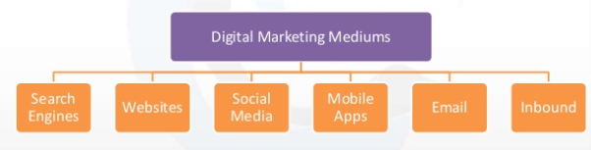
What is Digital Marketing ?
Digital marketing is the promotion of products or services using digital technologies like Internet.

Slide 3

What is Machine Learning
Machine learning is a field of computer science that uses statistical techniques to give computer systems the ability to "learn" with data, without being explicitly programmed.
In real life, machine learning is used in Self Driving Cars, Robots, Google Assistant etc.

Slide 4
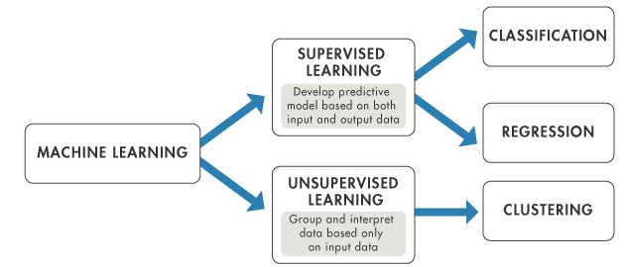
Learning Algorithms

Slide 5
Data Analytics
There are Four types of data analytics that really aid business :
Descriptive – What is happening now based on incoming data. To mine the analytics, you typically use a real-time dashboard and/or email reports.
Diagnostic – A look at past performance to determine what happened and why. The result of the analysis is often an analytic dashboard.
Predictive – An analysis of likely scenarios of what might happen. The deliverables are usually a predictive forecast.
Prescriptive – This type of analysis reveals what actions should be taken. This is the most valuable kind of analysis and usually results in rules and recommendations for next steps.

Slide 6
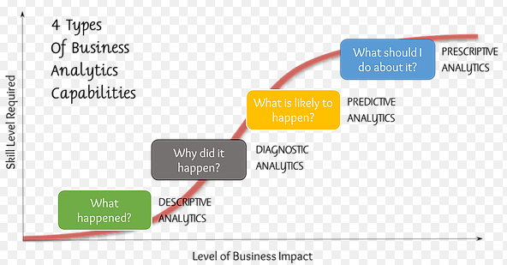

Slide 7
Data
The dataset is obtained from the retail-store based in US.
The data has been collected over the period of 4years from 2014-17
There has been a total of 793 customers from 49 different states with 1850 products.
Some of the features available in the dataset are Customer Name, Product Name, Order-Date, M.R.P, Profit, Quantity Sold, Discount.

Slide 8
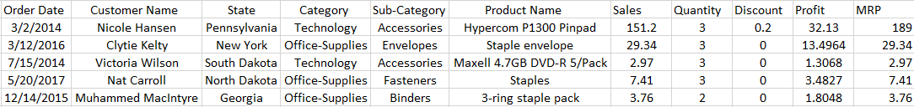

Slide 9
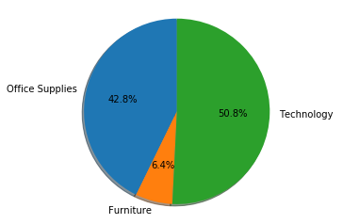
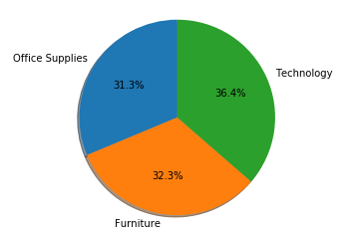
Category wise Analysis
Profit
Sales

Slide 10
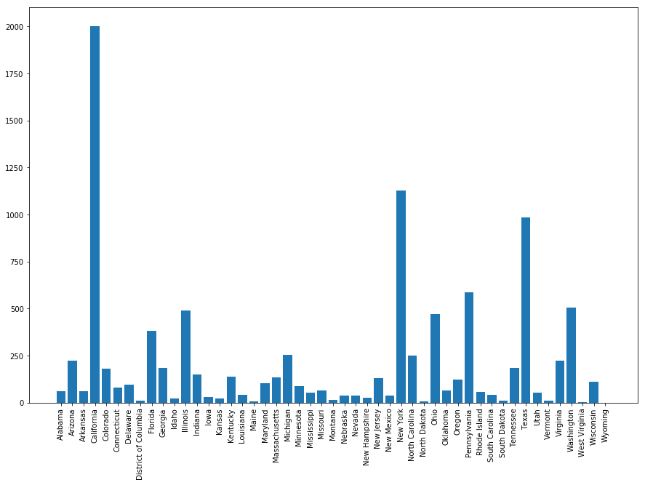
State-Wise Analysis

Slide 11
Digital marketing - Retail Store
The project is to build good models for various marketing activities, exploring the usage of both structured and unstructured data.
The following are the use-cases of the project:
Inventory management
Dynamic Pricing
Customer Segmentation
Target Marketing
Recommended system
Product Recommendation
Customer Recommendation.

Slide 12
Inventory Management
Descriptive Analytics
Predictive Analytics
Linear Regression
Inventory management as an element of supply chain management, includes aspects such as controlling and overseeing ordering inventory, storage of inventory, and controlling the amount of product for sale.
Inventory control is also important to maintaining the right balance of stock in your warehouses, too much inventory can trigger profit losses––whether a product expires, gets damaged, or goes out of season.

Slide 13
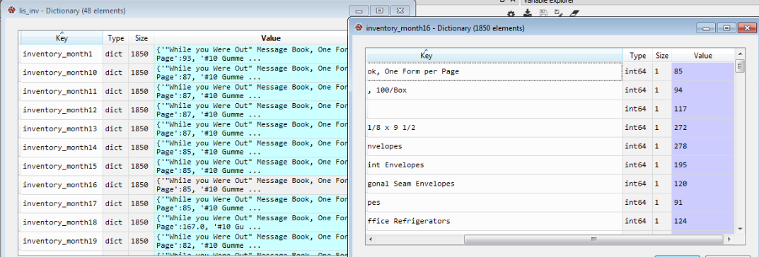
Extracted the pattern of inventory for all products for a period of 48 months. (Descriptive Analytics)
Based on profits and quantity sold of products they are classified as best, moderate, worst and High, Medium, Low respectively.
Inventory was managed by taking above parameters.
Based on product & given date the predicted sales for next 3 months are calculated by using Linear Regression. (Predictive Analytics)

Slide 14
Dynamic Pricing
Logistic Regression
It gives ecommerce retailers the right data and information that can be used to set optimal discount/price to the product and stay profitable despite the price fluctuations.
Logistic Regression used to tell the retailer whether to give discount to the product or not based on various features of the product.

Slide 15
Customer Segmentation
RFM Score
Logistic Regression
Customer Segmentation is the practice of dividing a customer base into groups of individuals that are similar in specific ways relevant to marketing . This is implemented using RFM.
RFM (Recency, Frequency, Monetary) is a very Simple Technique that we can apply to get the super useful analysis for our Customer Segmentation.
Recency (R) : How many days ago was their last purchase?
Frequency (F) : How many times has the customer purchased from our store?
Monetary (M) : How much money has this customer spent?

Slide 16
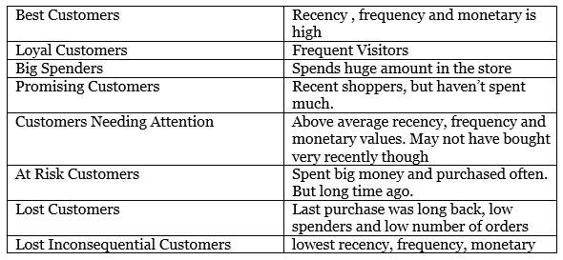
Categories of Customers

Slide 17
Targeted Marketing
Targeted Marketing is the process of dividing a large market into smaller pieces based on one or more meaningful shared characteristics and they will respond similarly to marketing action.
From the results obtained from Customer Segmentation, customers of different clusters are formed.
Based on the products what they are buying more and making more profits to the company for every customer their interested sub-categories are decided.
The offers are given on their interested products to people in some clusters in products interested by that group by sending E-mails.

Slide 18
Recommendation System
Association Rule Learning
Product Recommendations :
From the result obtained from classification of Products as best, Moderate and Worst products, analysis was done on best products.
Recommendation system generates score for all products taking one product at a time into consideration.
For each product, based on the scores the top five products are recommended.

Slide 19
Cosine Similarity
Pearson Correlation
Customer Recommendation :
The best customers and best products were considered
Using Cosine Similarity and Pearson Correlation a similarity score is generated
If the score > threshold, compare the purchase pattern and recommended products.

Slide 20
Thank you!

